Slide 1



USA Market Insights: Consumer Shopping Behavior
Trends in Online Shopping Transactions
Rohini Sidharth Kulkarni
DATA230 : Data Visualization
Dr. Andrew Bond

Slide 2

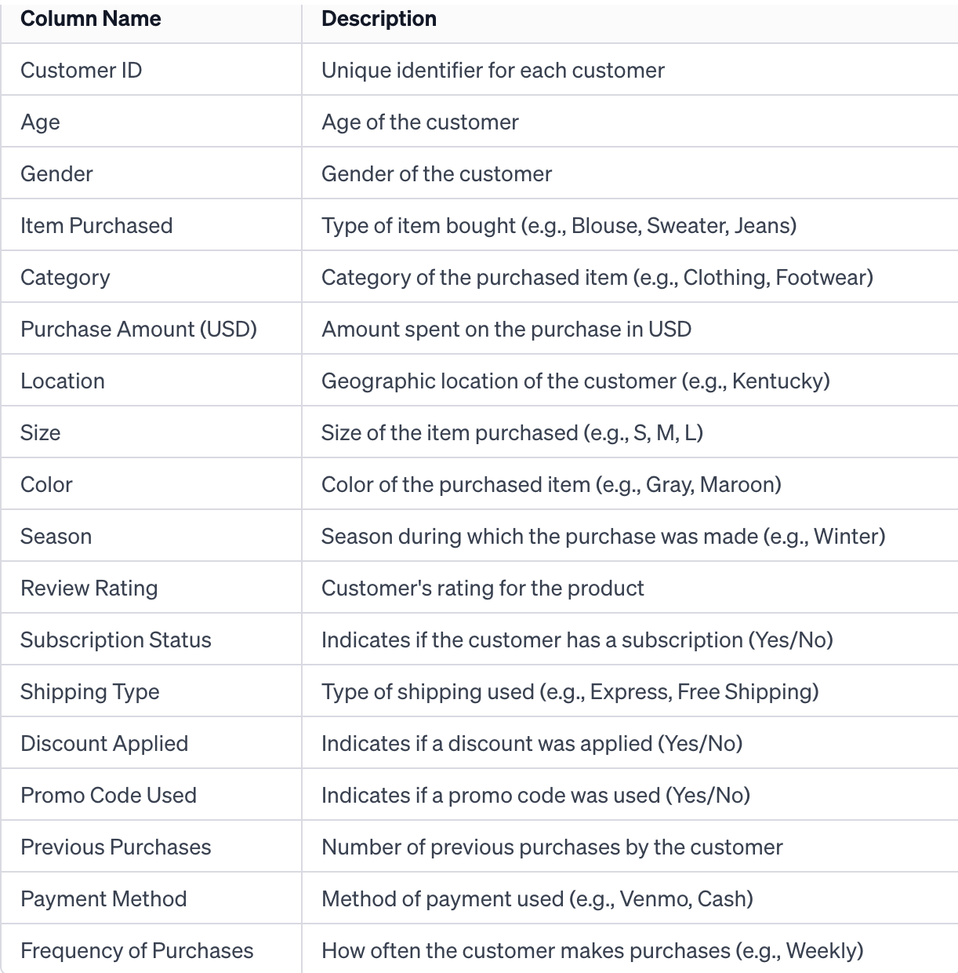
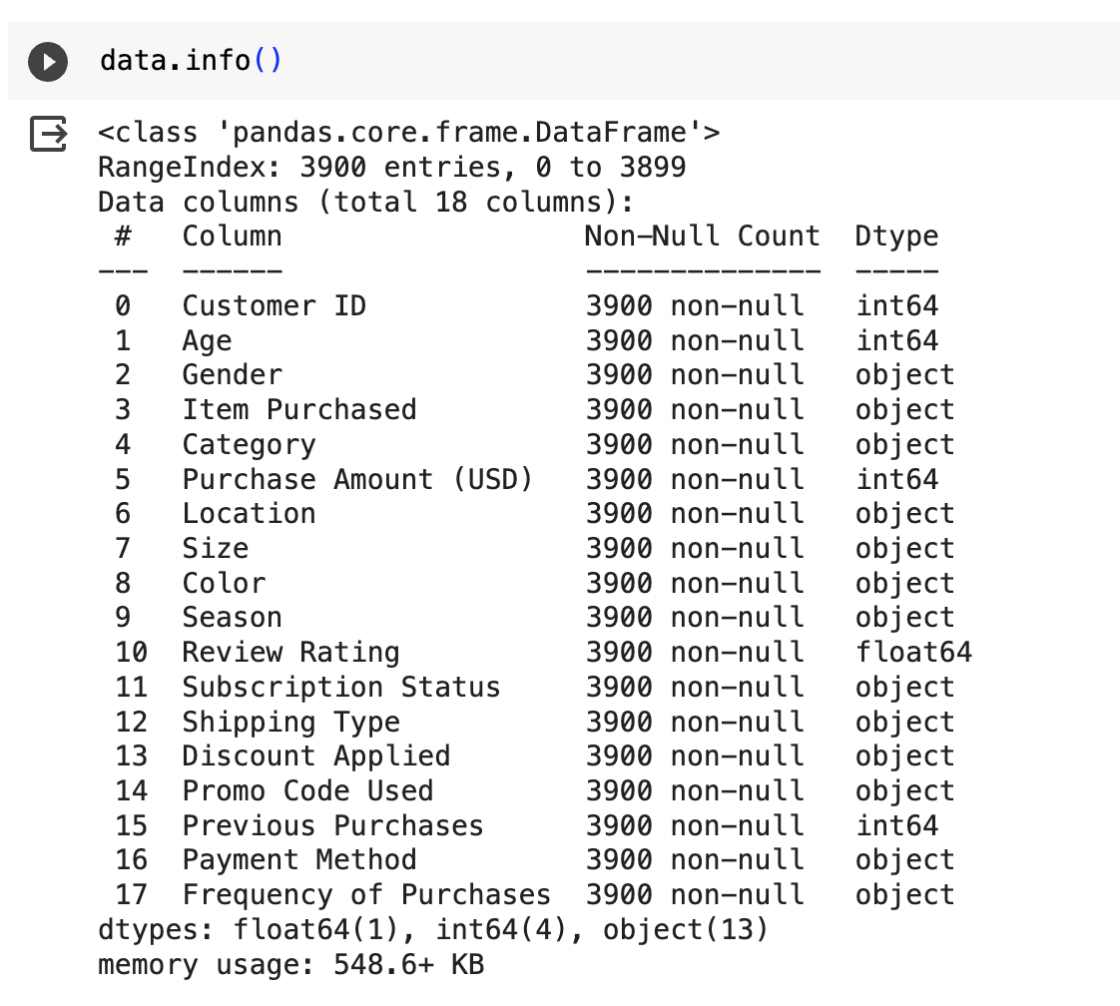

Dataset Description

Slide 3


Data Overview
The dataset covers a wide range of transactions, providing a detailed insight into consumer behavior across various product types, payment methods, and shopping frequencies.
The data spans a full calendar year, allowing for a better understanding of how consumer spending habits change seasonally and how these patterns can help inform yearly retail strategies.
-It includes different product categories such as Clothing, Footwear, Accessories, and Outerwear, enabling an analysis of preferences and trends across different segments of the retail market.

Slide 4


Visualization Summary
An analysis of consumer spending behavior reveals significant fluctuations across seasons, with Winter and Summer showing higher purchase volumes.
Consumers have distinct preferences for payment methods that align with their purchase frequency.
To enhance the shopping experience, it is advisable to emphasize flexible payment options and streamline the checkout process for popular methods such as Credit/Debit Cards and PayPal.
Age and location are key factors that influence purchase behavior, with specific demographic groups favoring certain products.

Slide 5
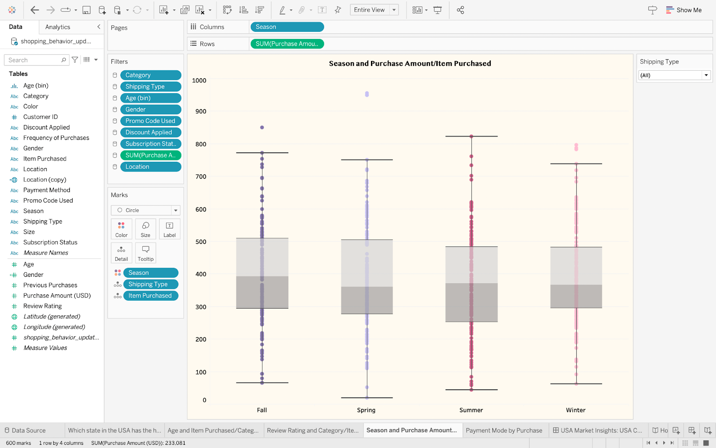
Seasonal Trends

Slide 6
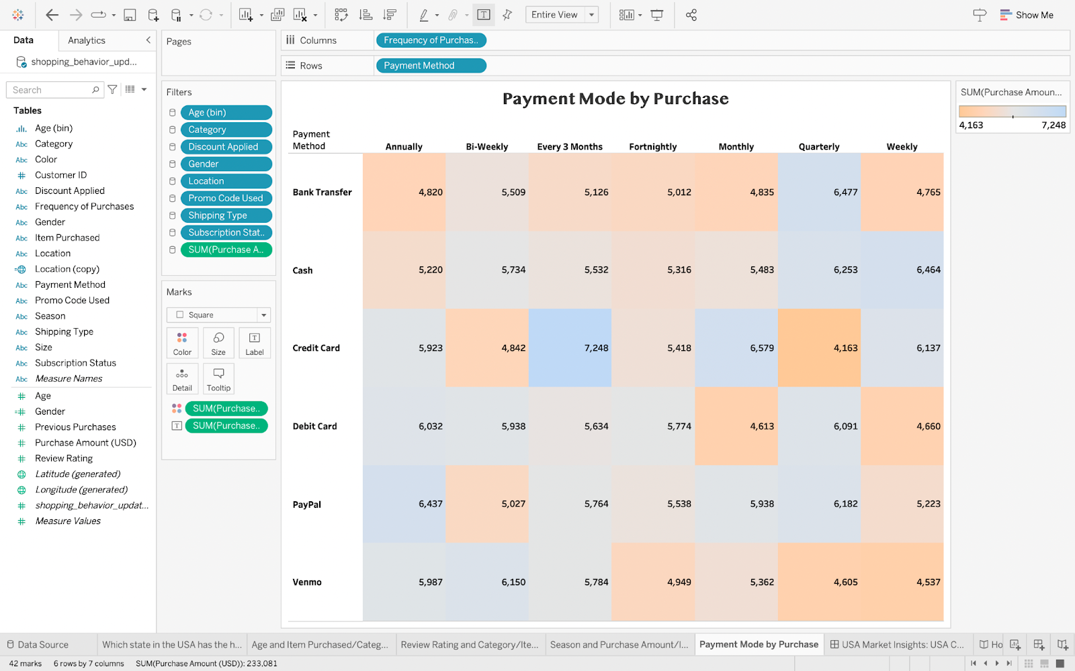
Payment Method Analysis

Slide 7
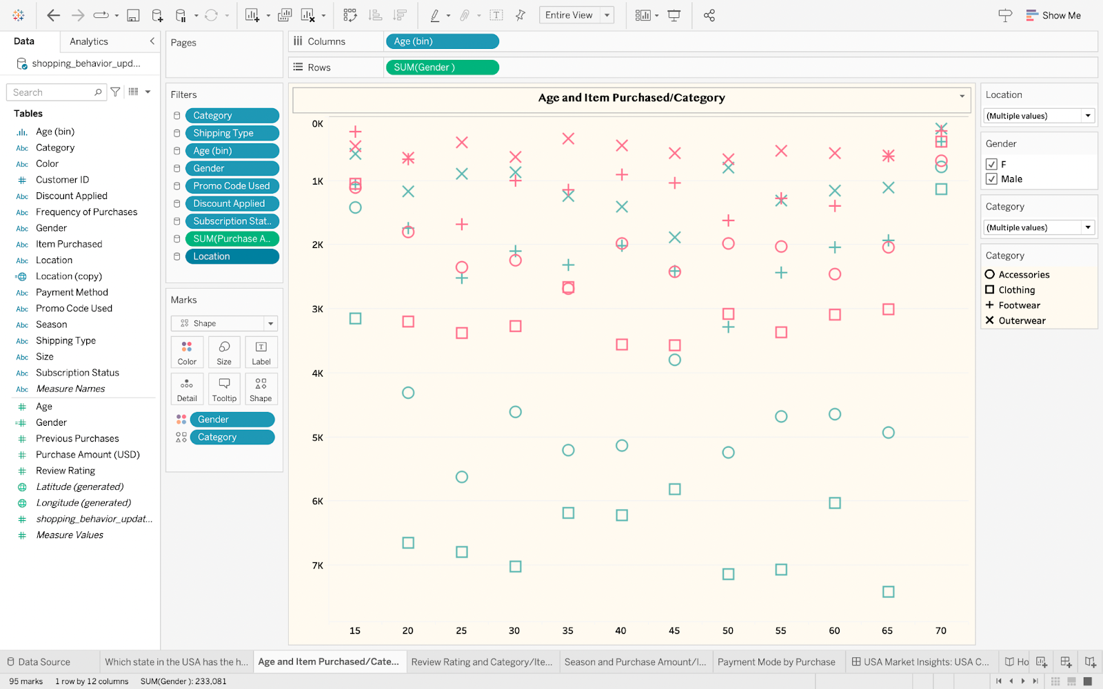
Demographic Breakdown

Slide 8
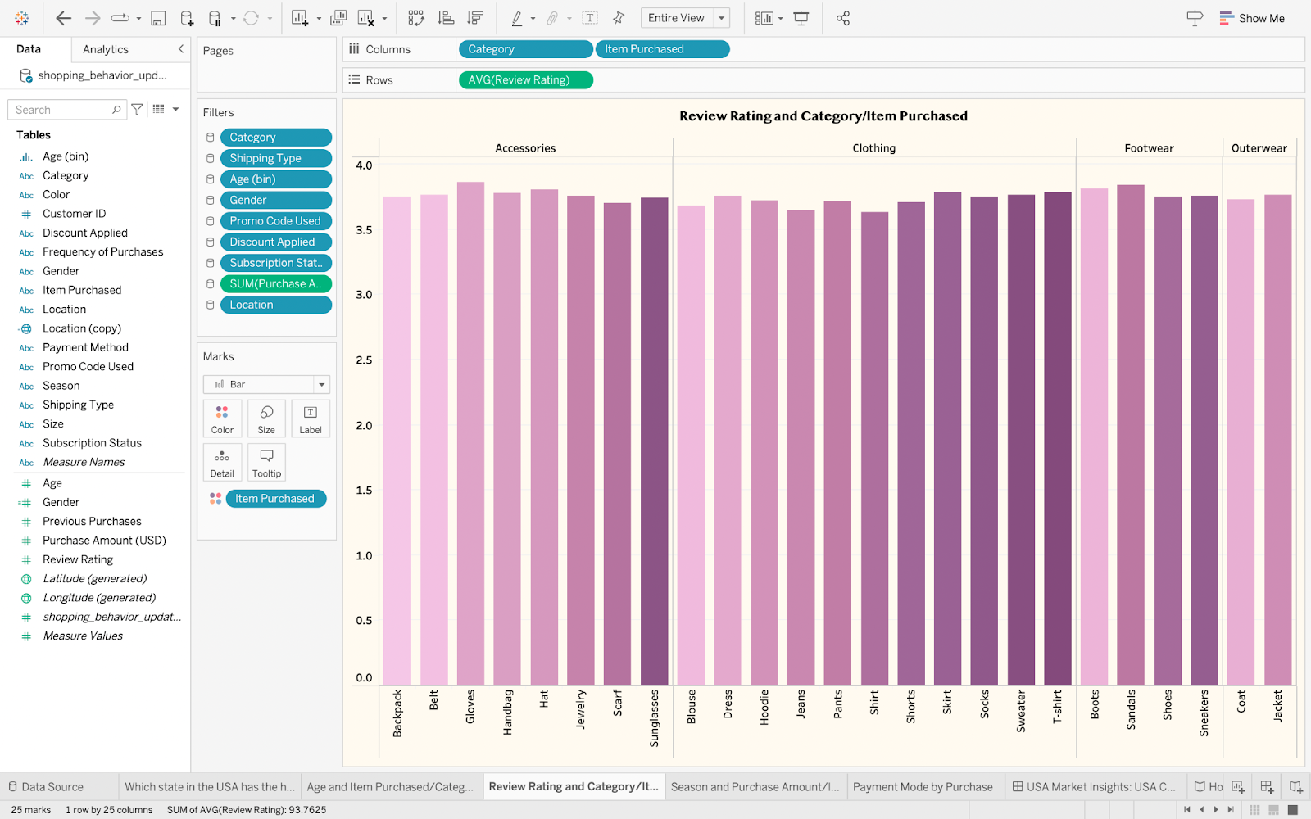
Categories Preference

Slide 9
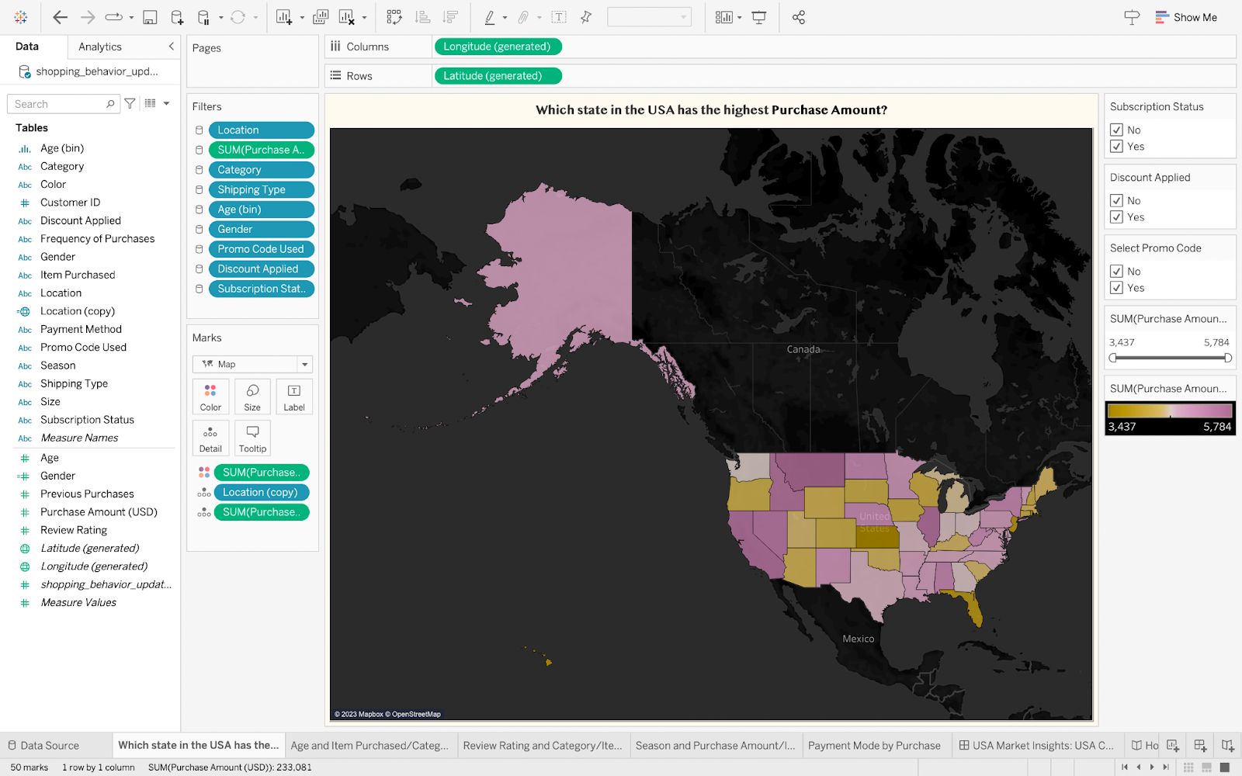
Geographic Impact

Slide 10
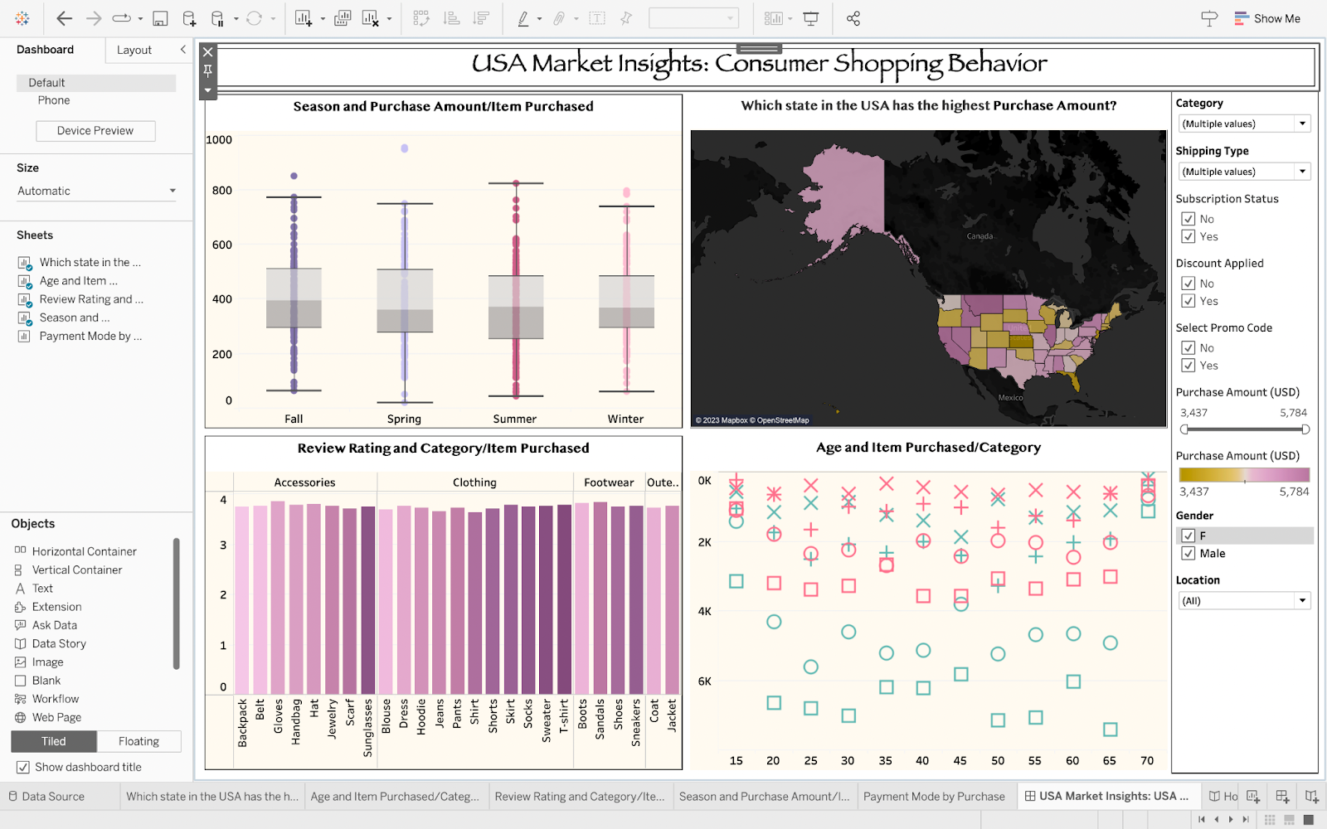
Interactive Dashboard

Slide 11
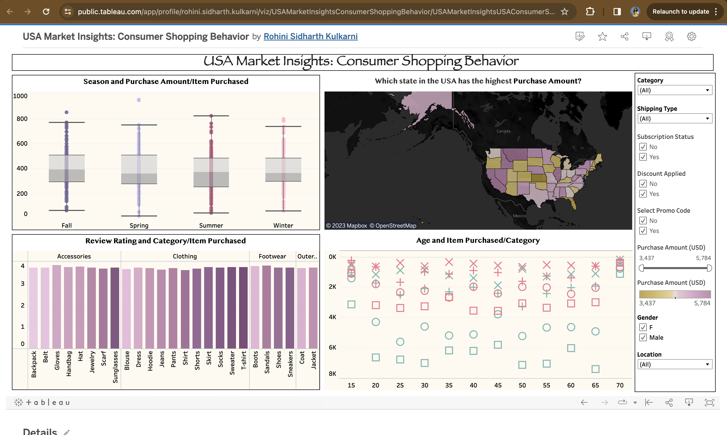
Tableau Public Interactive Dashboard

Slide 12
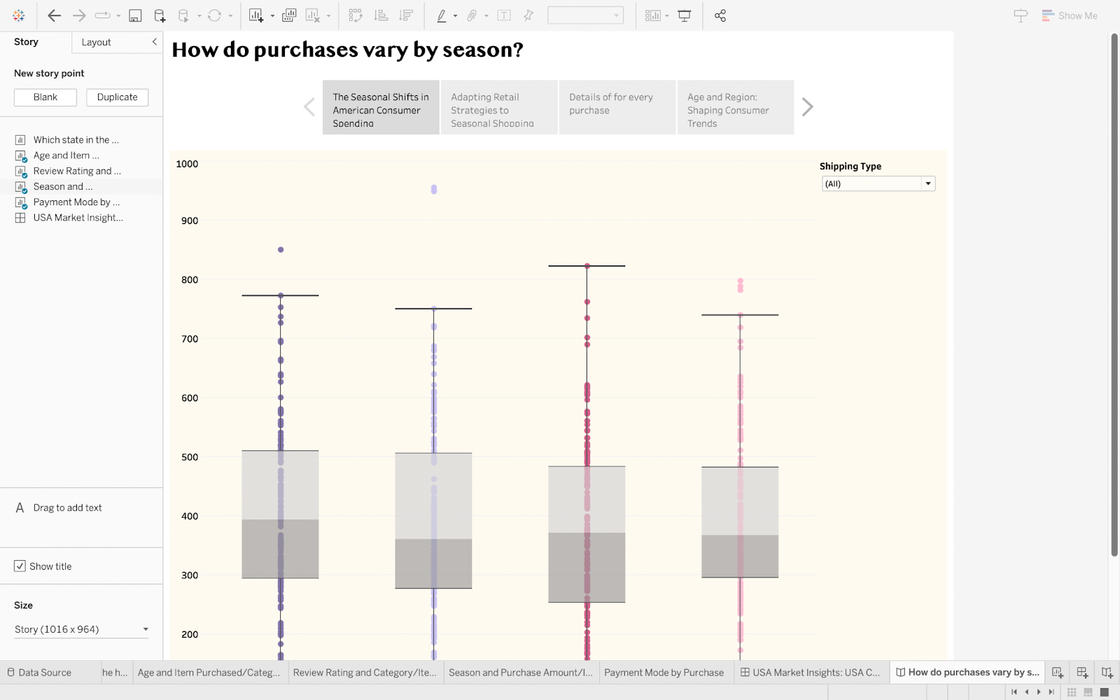
Interactive Story

Slide 13
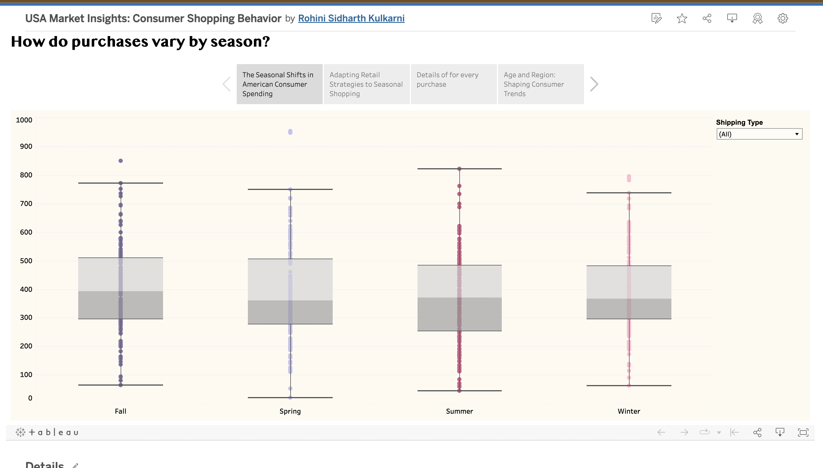
Tableau Public Interactive Story

Slide 14
Future Analysis
Longitudinal Trends: Analyze spending patterns over time to identify trends, economic impacts on consumer behavior, and shifts in preferences. Use these insights to inform strategic planning and forecasting.
Subcategory Detailing: Analyze product subcategories and identify top-selling items to improve inventory control and targeted marketing.
Customer Segmentation Deep Dive: Use advanced analytics with behavioral and psychographic data to segment customers for personalized marketing and product development.

Slide 15
Q&A

